Slide 1
Trump to unveil tax cut he says could be biggest ever (FoxNews)
President Trump on Friday said businesses and individuals will receive a "massive tax cut" under a tax reform package he plans to unveil next week.
In an interview with The Associated Press, Trump said the plan will result in tax cuts for both individuals and businesses. He would not provide details of the plan, saying only that the tax cuts will be "bigger I believe than any tax cut ever."
The president said the package will be released on "Wednesday or shortly thereafter" — just before his 100 day mark in office. He will face opposition in Congress as the possibility of a government shutdown by the end of the month lingers.

Slide 2
Written response
Are tax cuts, bigger “than any tax cut ever”, a good idea at this point in time? Why or why not?

Slide 3
Economic Objectives

Slide 4
Economic Objectives
Full employment
Low and stable inflation
High economic growth
Income equity

Slide 5
Aggregate Demand

Slide 6
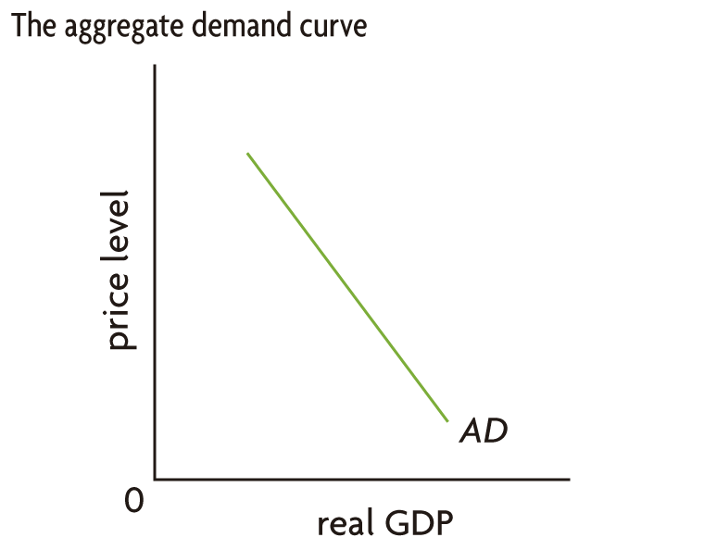
Aggregate Demand
Four parts of aggregate demand
Demand of consumers (C)
Demand of businesses (I)
Demand of government (G)
Net exports (X-M)

Slide 7
Demand-side policies
Government actions taken to move AD

Slide 8
Fiscal Policy

Slide 9
Fiscal Policy
What is fiscal policy?
Government changes in spending and taxes that are done to move aggregate demand (AD)

Slide 10
Fiscal Policy
How does the government move aggregate demand (AD)?
Aggregate Demand = C+I+G+(X-M)
G - Government can change its spending
C – Government can change taxes on consumers
I – Government can change taxes on business profits

Slide 11
Expansionary Fiscal Policy
Government actions to move the AD curve to the right and fix a recessionary gap.
Increasing government spending
Decreasing taxes
Both

Slide 12
Contractionary Fiscal Policy
Government actions to move the AD curve to the left and fix an inflationary gap.
Decreasing government spending
Increasing taxes
Both

Slide 13
Not all spending and taxes are the same
Expansionary Policy
Contractionary Policy
Increasing government spending
Decreasing taxes
Both
Decreasing government spending
Increasing taxes
Both

Slide 14
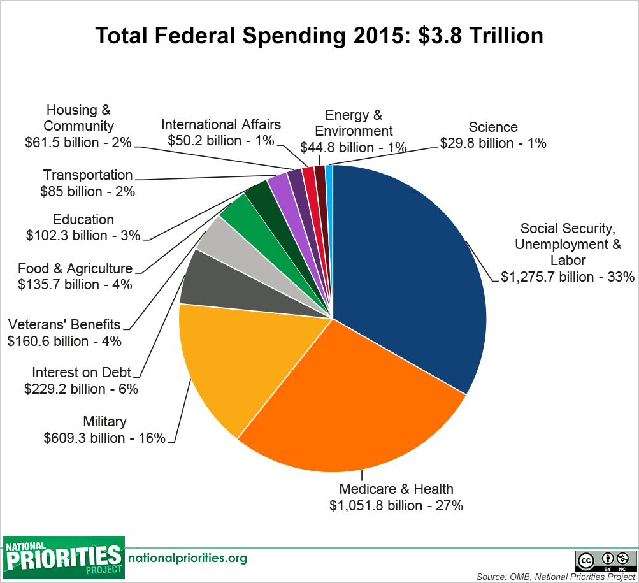
Total Spending = $3.803 trillion
G = 33% of GDP

Slide 15
Unemployment
To fix unemployment requires expansionary or contractionary fiscal policy?
EXPANSIONARY POLICY – increase spending and decrease taxes

Slide 16
Government Budget
Budget Deficit
Increasing debt
Revenues
Expenditures
Budget Deficit

Slide 17
Inflation
To fix inflation requires expansionary or contractionary fiscal policy?
CONTRACTIONARY POLICY - decrease spending and increase taxes

Slide 18
What if we have both unemployment and inflation at the same time?
Fiscal policy alone cannot solve both unemployment and inflation.

Slide 19
Written response
Are tax cuts, bigger “than any tax cut ever”, a good idea at this point in time?
Why or why not?

Slide 20
Economic Objectives
Full employment
Low and stable inflation
High economic growth
Income equity

Slide 21
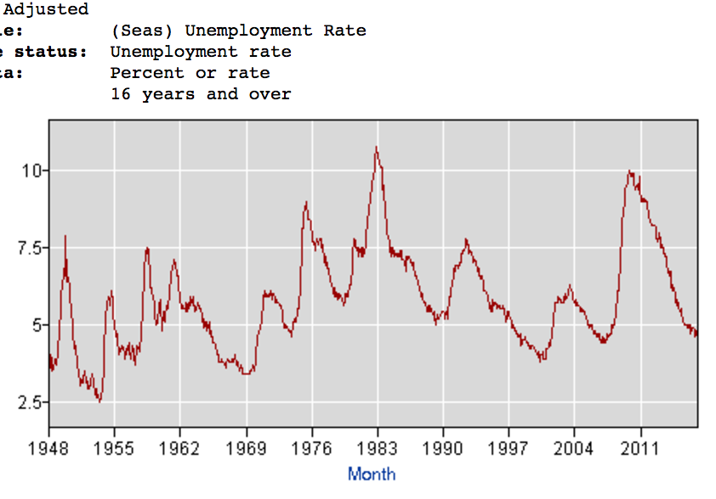
Unemployment Rate = 4.5%

Slide 22
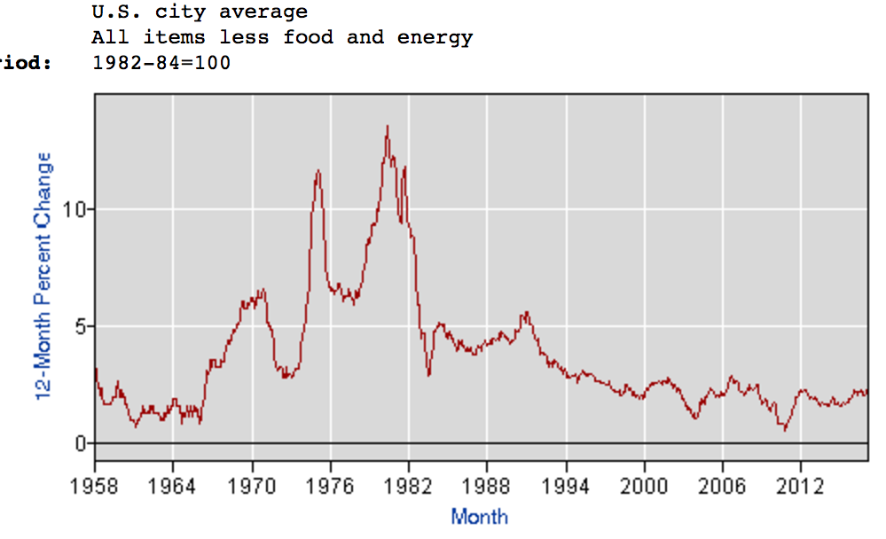
Inflation = 2%

Slide 23
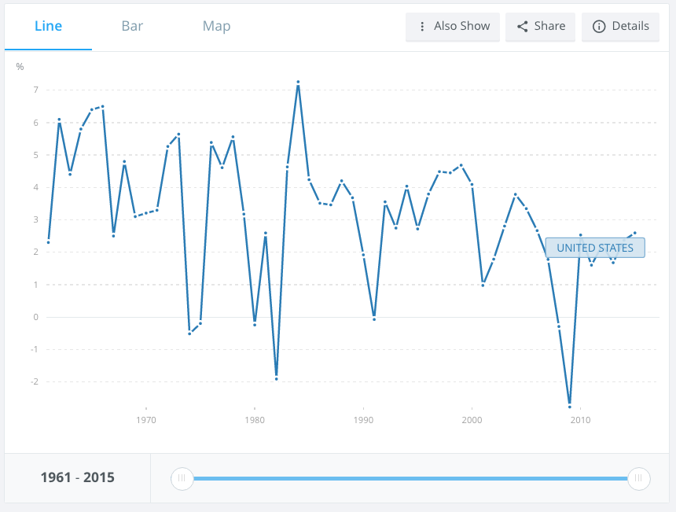
Economic Growth = 1.6%

Slide 24
Written response
Are tax cuts, bigger “than any tax cut ever”, a good idea at this point in time? Why or why not?

